Slide 1

Chapter 20
Network Layer:
Internet Protocol
20.<number>
Copyright © The McGraw-Hill Companies, Inc. Permission required for reproduction or display.

Slide 2
20-1 INTERNETWORKING
In this section, we discuss internetworking, connecting networks together to make an internetwork or an internet.
Topics discussed in this section:
Need for Network Layer
Internet as a Datagram Network
Internet as a Connectionless Network
20.<number>

Slide 3

Figure 20.1 Links between two hosts
20.<number>

Slide 4

Figure 20.2 Network layer in an internetwork
20.<number>

Slide 5

Figure 20.3 Network layer at the source, router, and destination
20.<number>

Slide 6

Figure 20.3 Network layer at the source, router, and destination (continued)
20.<number>

Slide 7
Packet Switching
Data transmitted in small packets
  Typically less than 1500 bytes (why?)
  Longer messages split into series of packets
  Each packet contains a portion of user data plus some control info
Control info
  Routing (addressing) info
Packets are received, stored briefly (buffered) and past on to the next node
  Store and forward
William Stallings.. Data and Computer Communications, 7/E, Prentice Hall, 2004.

Slide 8
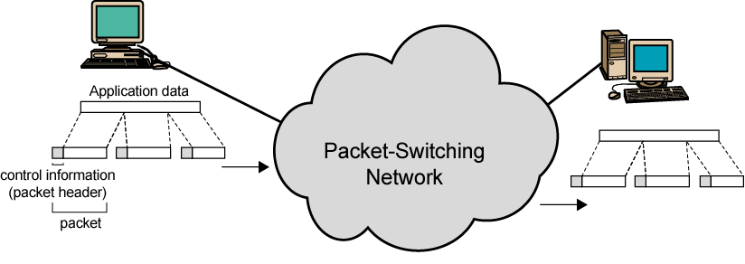
Use of Packets
William Stallings.. Data and Computer Communications, 7/E, Prentice Hall, 2004.

Slide 9
Switching Technique
Station breaks long message into packets
Packets sent one at a time to the network
Packets handled in two ways
  Datagram
  Virtual circuit
William Stallings.. Data and Computer Communications, 7/E, Prentice Hall, 2004.

Slide 10
Datagram
Each packet treated independently
Packets can take any practical route
Packets may arrive out of order
Packets may go missing
Up to receiver to re-order packets and recover from missing packets
William Stallings.. Data and Computer Communications, 7/E, Prentice Hall, 2004.

Slide 11
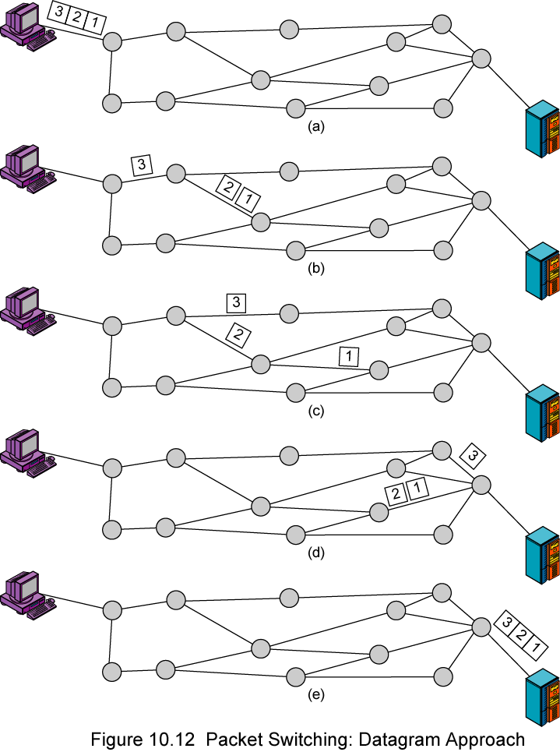
Datagram
Diagram
William Stallings.. Data and Computer Communications, 7/E, Prentice Hall, 2004.

Slide 12
Virtual Circuit
Preplanned route established before any packets sent
Call request and call accept packets establish connection (handshake)
Each packet contains a virtual circuit identifier instead of destination address
No routing decisions required for each packet
Clear request to drop circuit
Not a dedicated path
William Stallings.. Data and Computer Communications, 7/E, Prentice Hall, 2004.

Slide 13
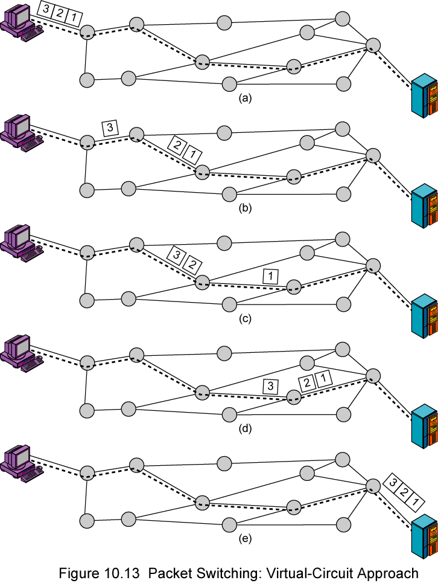
Virtual
Circuit
Diagram
William Stallings.. Data and Computer Communications, 7/E, Prentice Hall, 2004.

Slide 14
Virtual Circuits v Datagram
Virtual circuits
  Network can provide sequencing and error control
  Packets are forwarded more quickly
    No routing decisions to make
  Less reliable
    Loss of a node looses all circuits through that node
Datagram
  No call setup phase
    Better if few packets
  More flexible
    Routing can be used to avoid congested parts of the network
William Stallings.. Data and Computer Communications, 7/E, Prentice Hall, 2004.

Slide 15

Note
Switching at the network layer in the Internet uses the datagram approach to packet switching.
20.<number>

Slide 16
Note
Communication at the network layer in the Internet is connectionless.
20.<number>

Slide 17
20-2 IPv4
The Internet Protocol version 4 (IPv4) is the delivery mechanism used by the TCP/IP protocols.
Topics discussed in this section:
Datagram
Fragmentation
Checksum
Options
20.<number>

Slide 18

Figure 20.4 Position of IPv4 in TCP/IP protocol suite
20.<number>

Slide 19
Note
IPv4 is an unreliable and connectionless datagram protocol – a best effort delivery
Best effort means that IPv4 provides no error control (except for error detection on the header) or flow control
IPv4 does its best to get a transmission through to its destination, but with no guarantees
20.<number>

Slide 20

Figure 20.5 IPv4 datagram format
20.<number>

Slide 21
IPv4 Datagram Format
Version (VER): version of the IP protocol. Currently, the version is 4.
Header length (HLEN): the total length of the datagram header in 4-byte words.
Services: service type or differentiated services (not used now).
Total length: total length (header plus data) of the datagram in bytes.
  Total length of data = total length – header length
20.<number>

Slide 22
IPv4 Datagram Format
Identification: used in fragmentation (discussed later).
Flags: used in fragmentation (discussed later).
Fragmentation offset: used in fragmentation (discussed later).
Time to live: it is used to control the maximum number hops visited by the datagram.
Protocol: defines the higher-level protocol that uses the services of the IPV4 layer.
20.<number>

Slide 23
IPv4 Datagram Format
Checksum: 1’s compliment checksum (introduced in Chapter 10).
Source address: is the IPv4 address of the source.
Destination address: is the IPv4 address of the source.
20.<number>

Slide 24
Note
The total length field defines the total length of the datagram including the header.
20.<number>

Slide 25

Figure 20.7 Encapsulation of a small datagram in an Ethernet frame
One of the reason why “total length”
field is required.
20.<number>

Slide 26

Figure 20.8 Protocol field and encapsulated data
20.<number>

Slide 27

Table 20.4 Protocol values
20.<number>

Slide 28
Example 20.1
An IPv4 packet has arrived with the first 8 bits as shown:
01000010
The receiver discards the packet. Why?
Solution
There is an error in this packet. The 4 leftmost bits (0100) show the version, which is correct. The next 4 bits (0010) show an invalid header length (2 × 4 = 8). The minimum number of bytes in the header must be 20. The packet has been corrupted in transmission.
20.<number>

Slide 29
Example 20.2
In an IPv4 packet, the value of HLEN is 1000 in binary. How many bytes of options are being carried by this packet?
Solution
The HLEN value is 8, which means the total number of bytes in the header is 8 × 4, or 32 bytes. The first 20 bytes are the base header, the next 12 bytes are the options.
20.<number>

Slide 30
Example 20.3
In an IPv4 packet, the value of HLEN is 5, and the value of the total length field is 0x0028. How many bytes of data are being carried by this packet?
Solution
The HLEN value is 5, which means the total number of bytes in the header is 5 × 4, or 20 bytes (no options). The total length is 40 bytes, which means the packet is carrying 20 bytes of data (40 − 20).
20.<number>

Slide 31

Figure 20.9 Maximum transfer unit (MTU)
20.<number>

Slide 32

Table 20.5 MTUs for some networks
20.<number>

Slide 33
Fields Related to Fragmentation
Identification: identifies a datagram originating from the source host. A combination of the identification and source address must uniquely define a datagram as it leaves the source node.
Flags: see next slide.
Fragmentation offset: is the offset of the data in the original datagram measured in units of 8 bytes.
20.<number>

Slide 34

Figure 20.10 Flags (3 bits) used in fragmentation
first bit: reserved (not used)
second bit: = 1 requires the packet not to be fragmented
drops the packet if it is > MTU
third bit: =1 more fragmented packets later
=0 the last fragmented packet
20.<number>

Slide 35

Figure 20.11 Fragmentation example
20.<number>

Slide 36
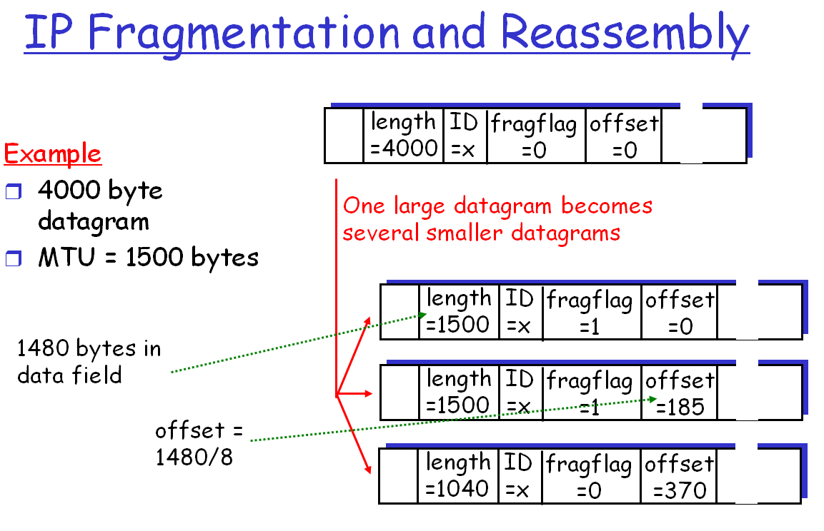
1060
20.<number>

Slide 37
IPv4 Checksum
IPv4 checksum use the 1’s compliment method (chapter 10)
Checksum only computes for IP header, not data
  Upper layer has checksum for data portion
  Header always changes in each router
Header is chunked to 16-bit sections for computing
20.<number>

Slide 38

Figure 20.13 Example of checksum calculation in IPv4
20.<number>

Slide 39
20-3 IPv6
The network layer protocol in the TCP/IP protocol suite is currently IPv4. Although IPv4 is well designed, data communication has evolved since the inception of IPv4 in the 1970s. IPv4 has some deficiencies that make it unsuitable for the fast-growing Internet.
Topics discussed in this section:
Advantages
Packet Format
Extension Headers
20.<number>

Slide 40
IPv6: Advantages
Larger address space.
Better header format.
New options.
Allowance for extensions.
Support for resource allocation.
Support for more security.

Slide 41

Figure 20.15 IPv6 datagram header and payload
20.<number>

Slide 42

Figure 20.16 Format of an IPv6 datagram
Priority
Protocol
20.<number>

Slide 43

Table 20.9 Comparison between IPv4 and IPv6 packet headers
20.<number>

Slide 44
20-4 TRANSITION FROM IPv4 TO IPv6
Because of the huge number of systems on the Internet, the transition from IPv4 to IPv6 cannot happen suddenly. It takes a considerable amount of time before every system in the Internet can move from IPv4 to IPv6. The transition must be smooth to prevent any problems between IPv4 and IPv6 systems.
Topics discussed in this section:
Dual Stack
Tunneling
Header Translation
20.<number>

Slide 45

Figure 20.18 Three transition strategies
20.<number>

Slide 46

Figure 20.19 Dual stack
Host uses DNS query result to determine which IP to use
20.<number>

Slide 47

Figure 20.20 Tunneling strategy
Popular used right now in many countries
20.<number>

Slide 48

Figure 20.21 Header translation strategy
20.<number>

